Slide 1
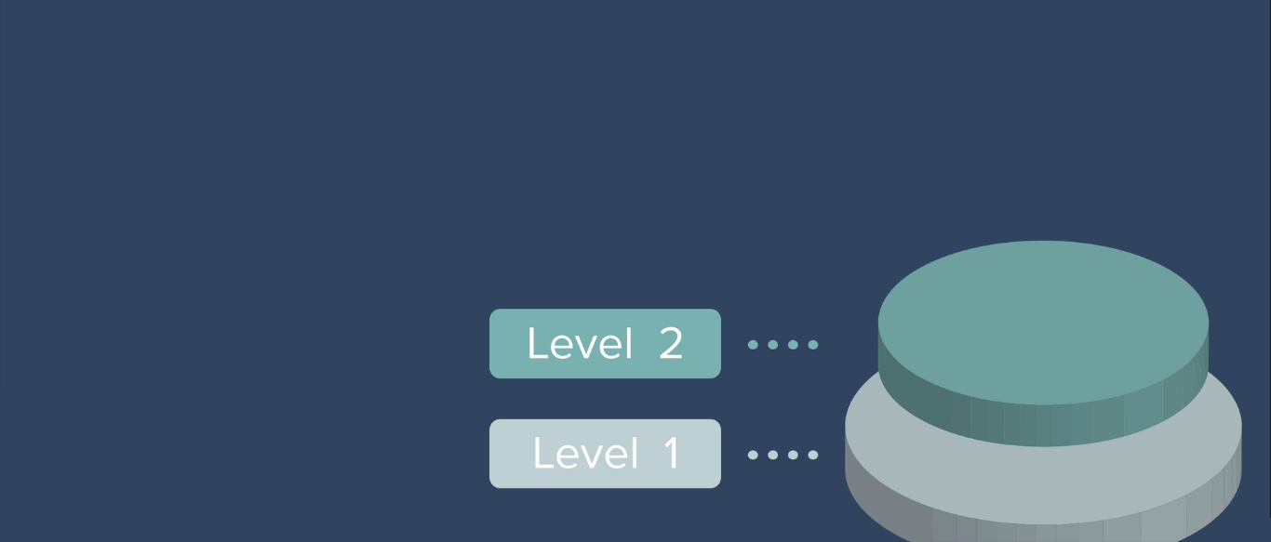
Learning Level 2 Security

Slide 2
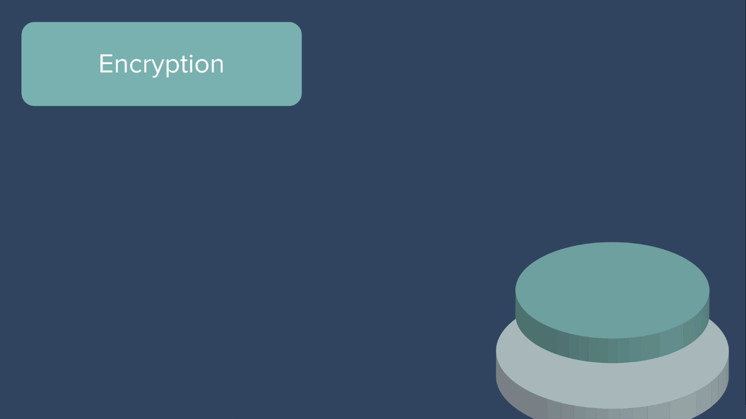
Learning Level 2 Security : Encryption / Decryption.

Slide 3

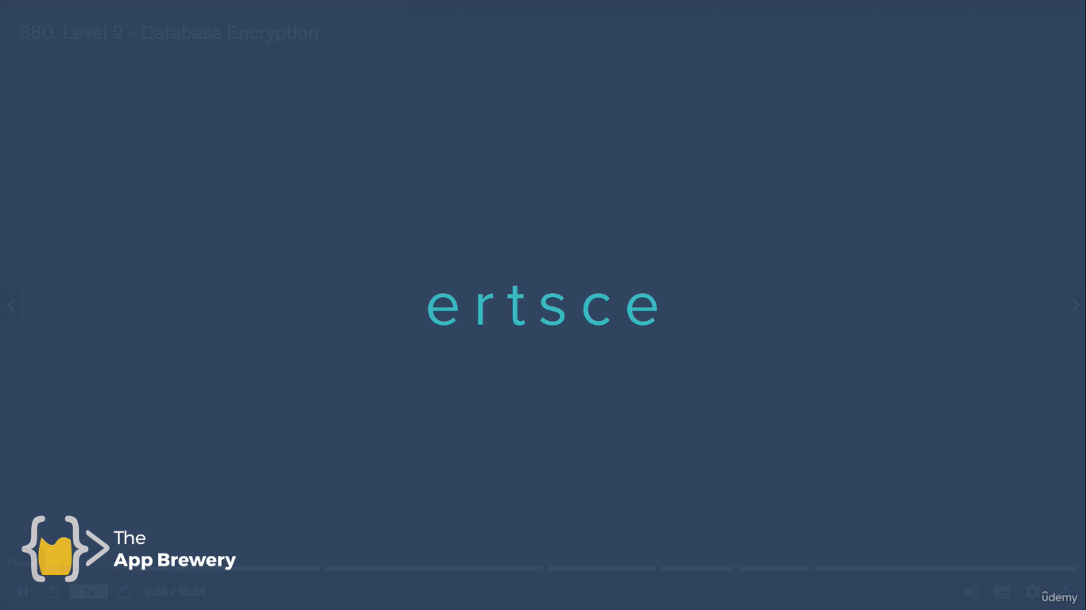
Actual String into exchange letters

Slide 4

What is enigma ?

Slide 5
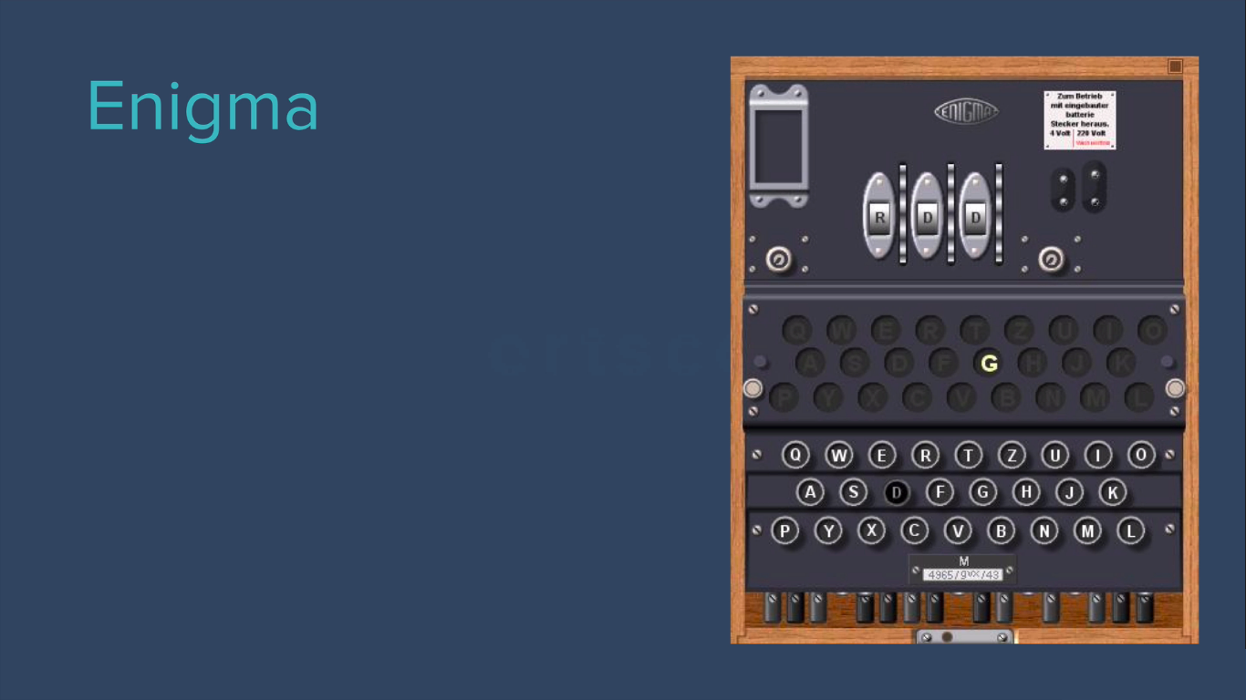
The machine used by German during World War-II

Slide 6
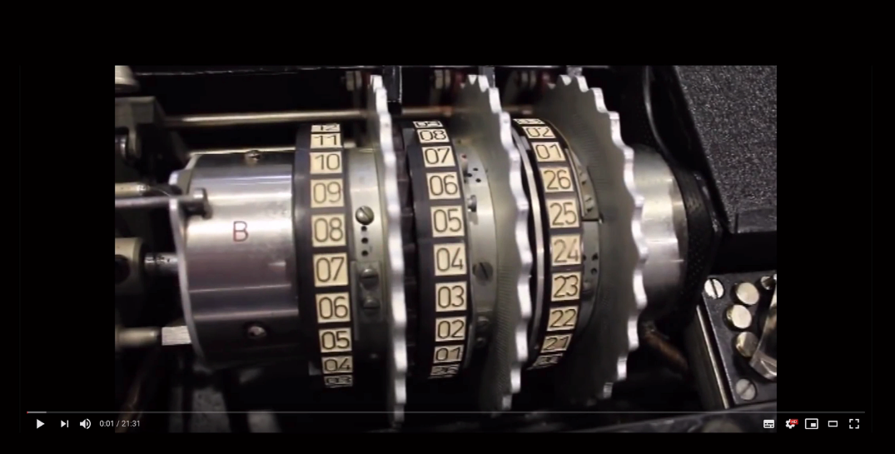
Watch Video to understand about Enigma machine working Principle
https://www.youtube.com/watch?v=G2_Q9FoD-oQ
To more scientific projects - https://www.numberphile.com/

Slide 7
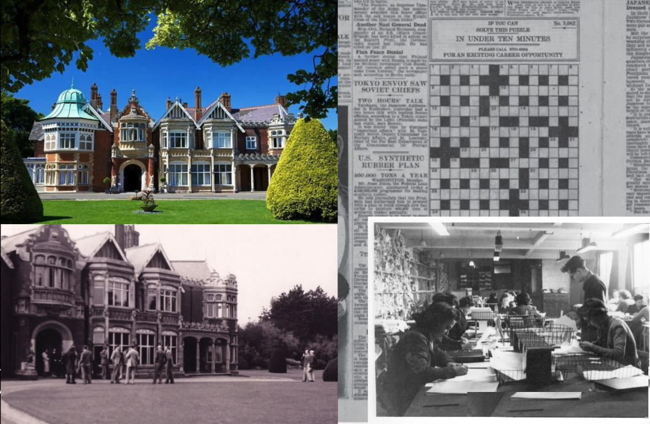
Enigma machine placed at Bletchley Park – Computer Museum
https://www.tnmoc.org/

Slide 8
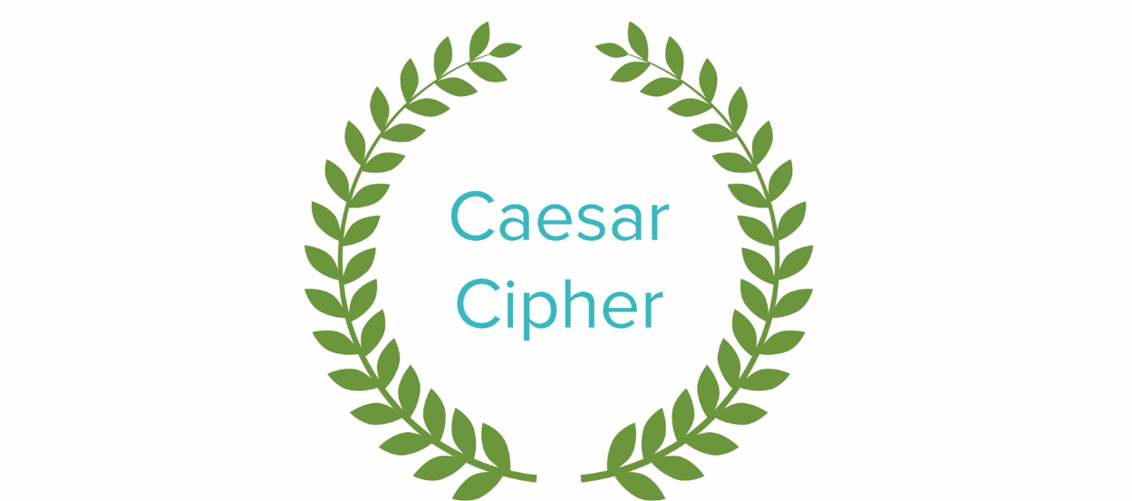
What is Caesar Cipher ?
https://en.wikipedia.org/wiki/Caesar_cipher

Slide 9
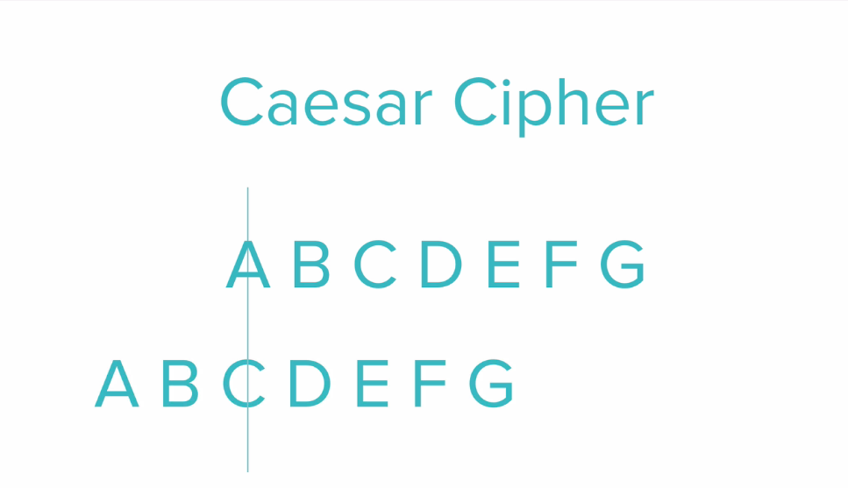
Letter Substitution & The Key is Shift Pattern.
(Cipher & decipher )

Slide 10
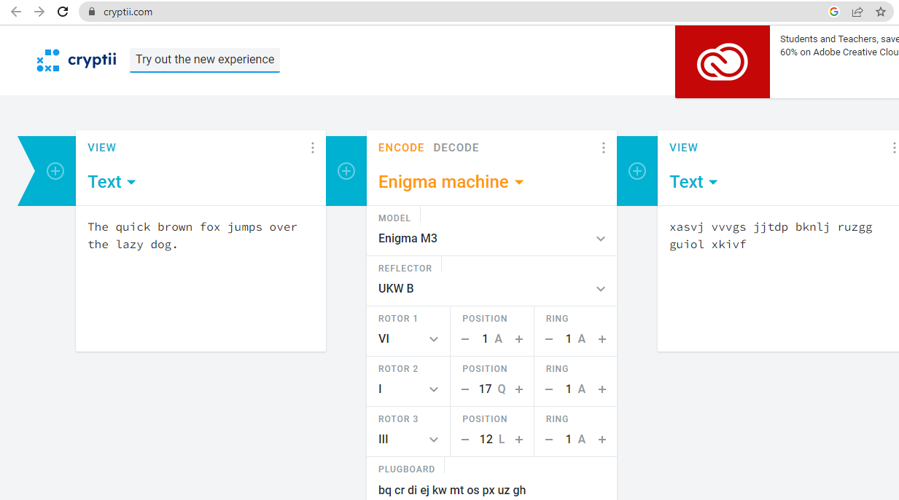
Visit → https://cryptii.com/

Slide 11
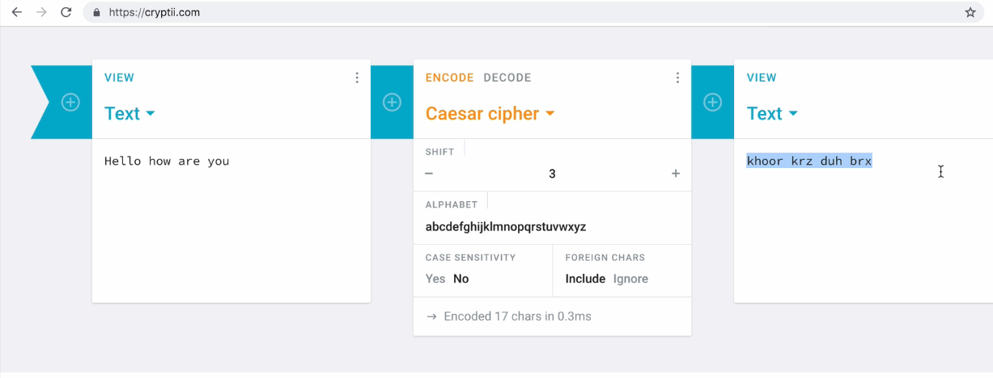
Choose Caesar Cipher – shift pattern is 3

Slide 12


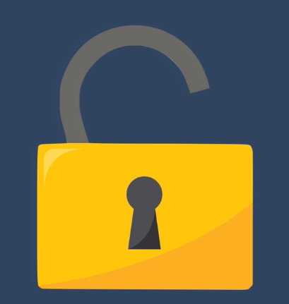
Key
Unscramble Message
Scramble Message

Slide 13
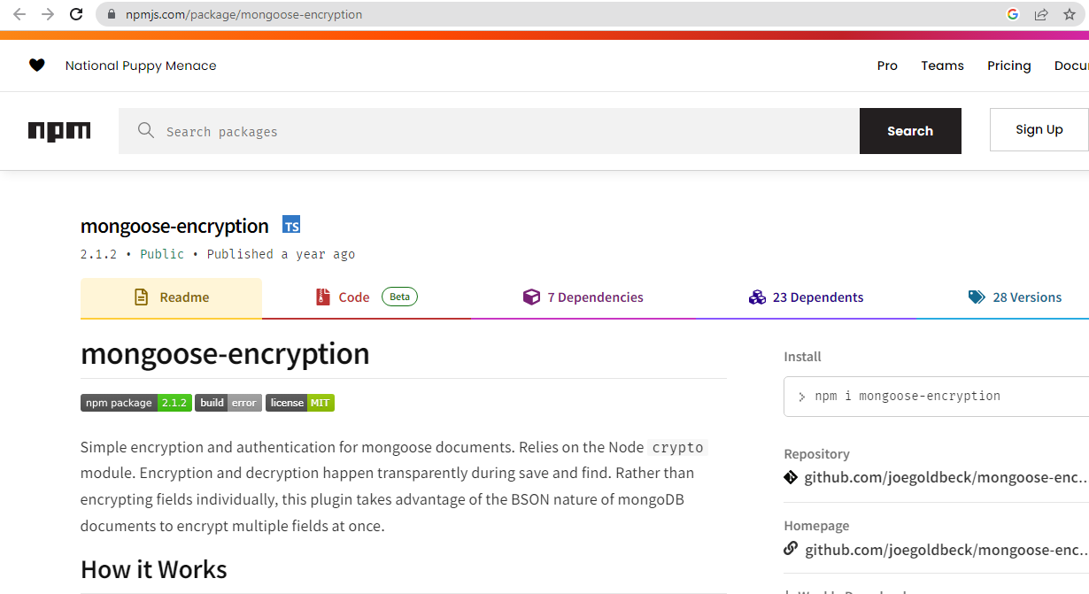
Implementing Encryption at password field in our database.

Slide 14
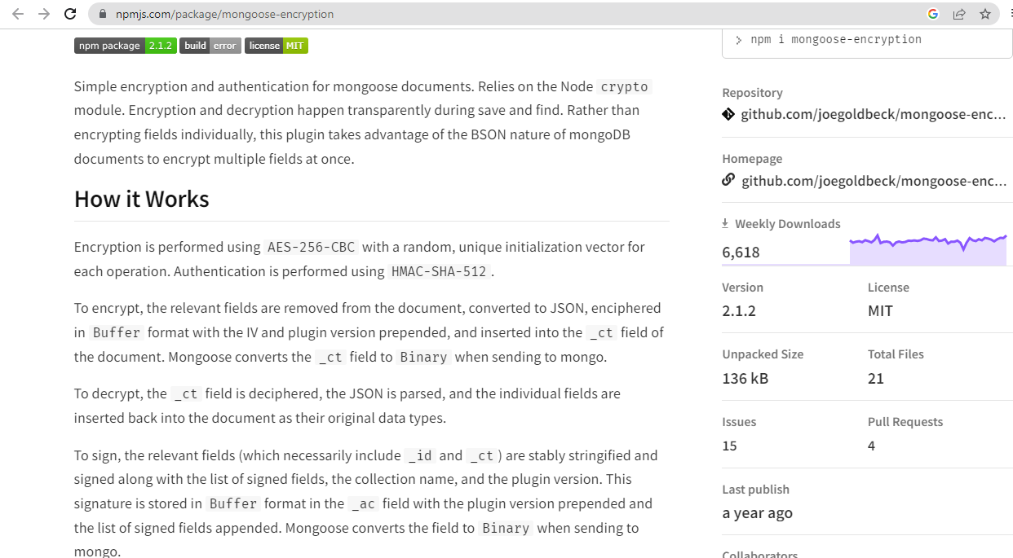
Implementing Encryption via modern AES Algorithm.

Slide 15
Implementing Encryption via modern AES Algorithm using mongoose encryption package.
When we read this package description , then we came to know that this package also supports authentication. It will be discussed on coming lessons.
So now install mongoose-encryption package in our secrets project using npm command.
> npm i mongoose-encryption

Slide 16
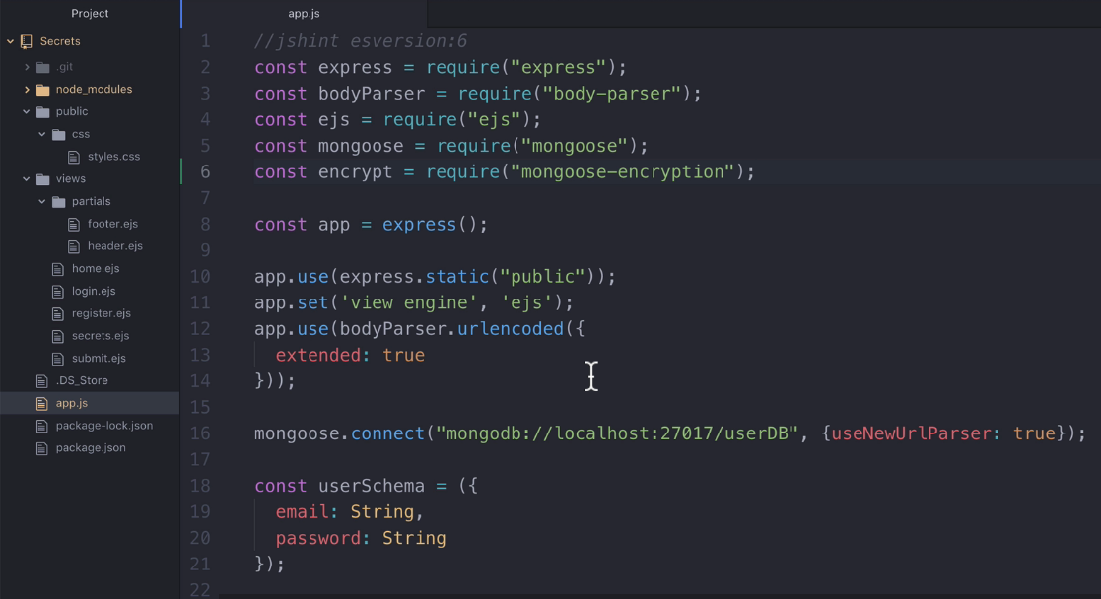
Adding mongoose-encryption package.

Slide 17
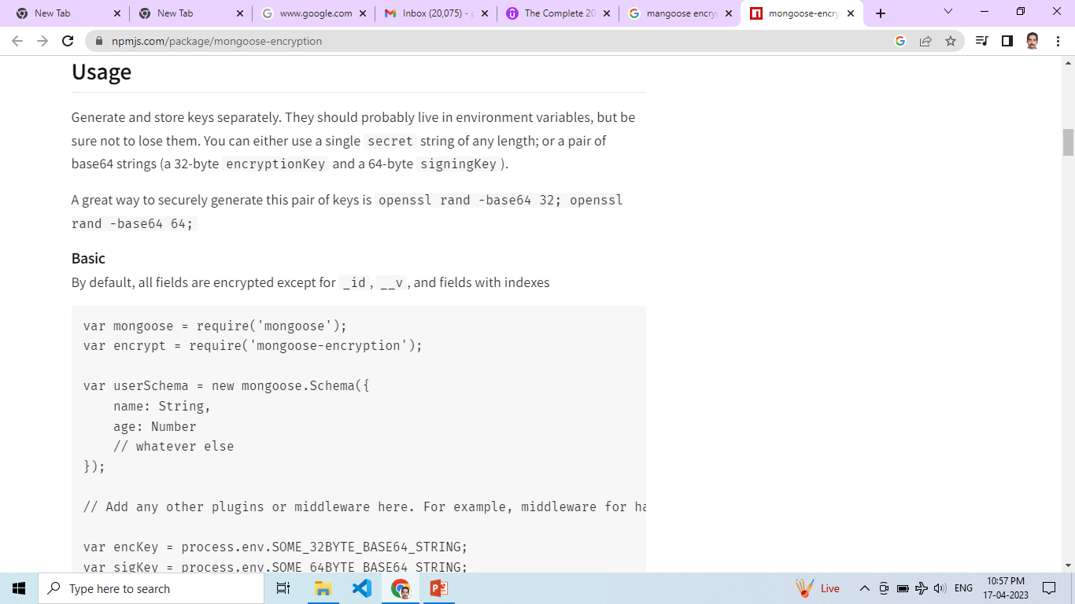
Refer Document: To know how to add mongoose schema.

Slide 18
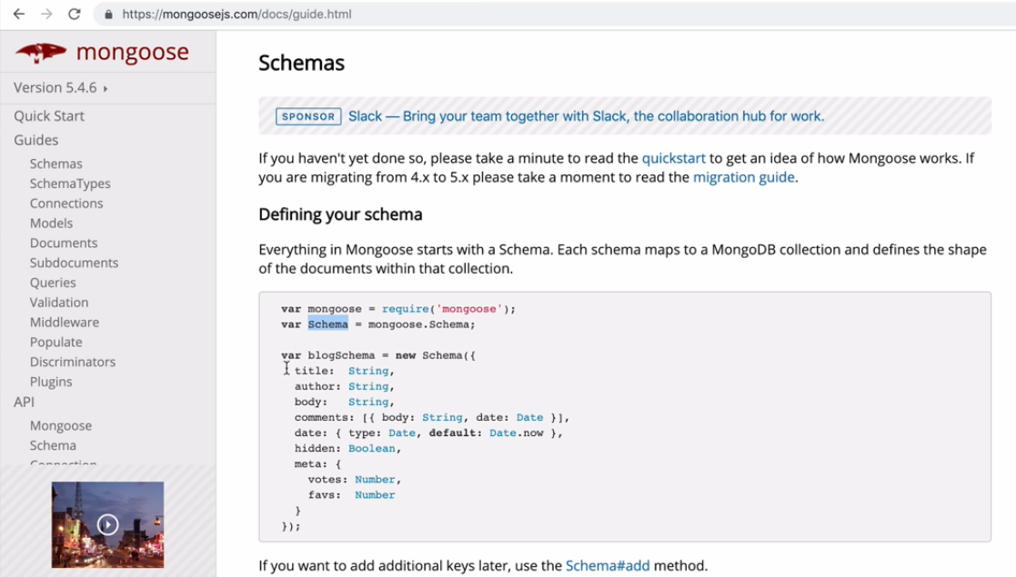
The purpose of adding mongoose schema is to simply use all its plugins inside our Code.

Slide 19
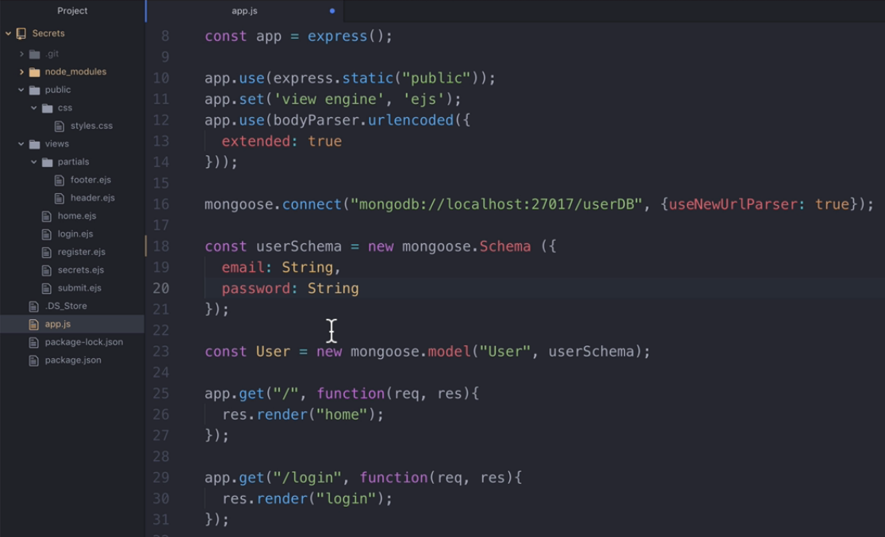
Creating userSchema object via mongoose schema class.

Slide 20
https://github.com/joegoldbeck/mongoose-encryption

Slide 21
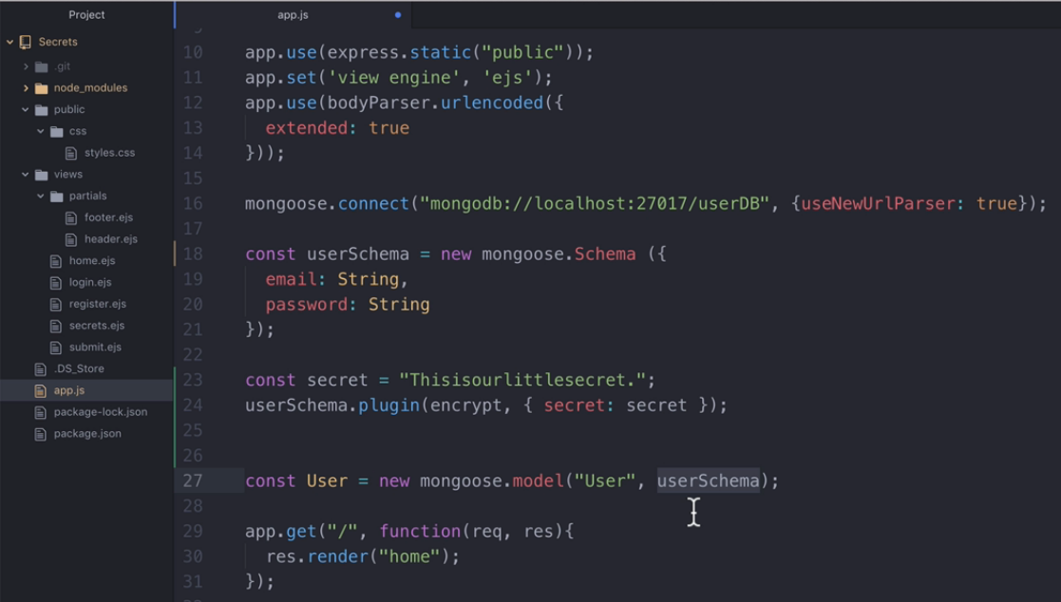
Creating secret string before mongoose model object

Slide 22
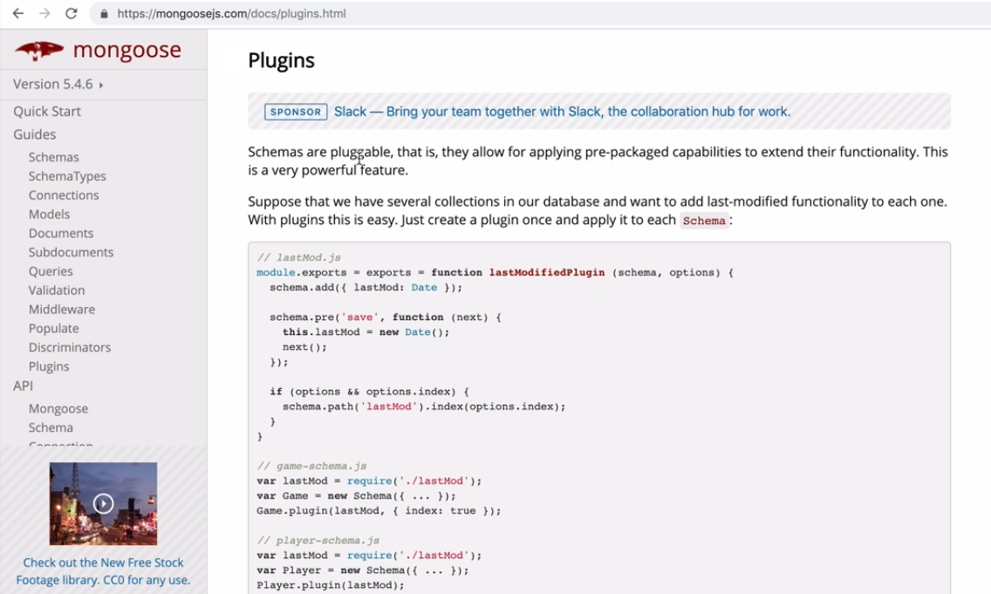
To know more about pulgins refer mongoose documentation page.

Slide 23
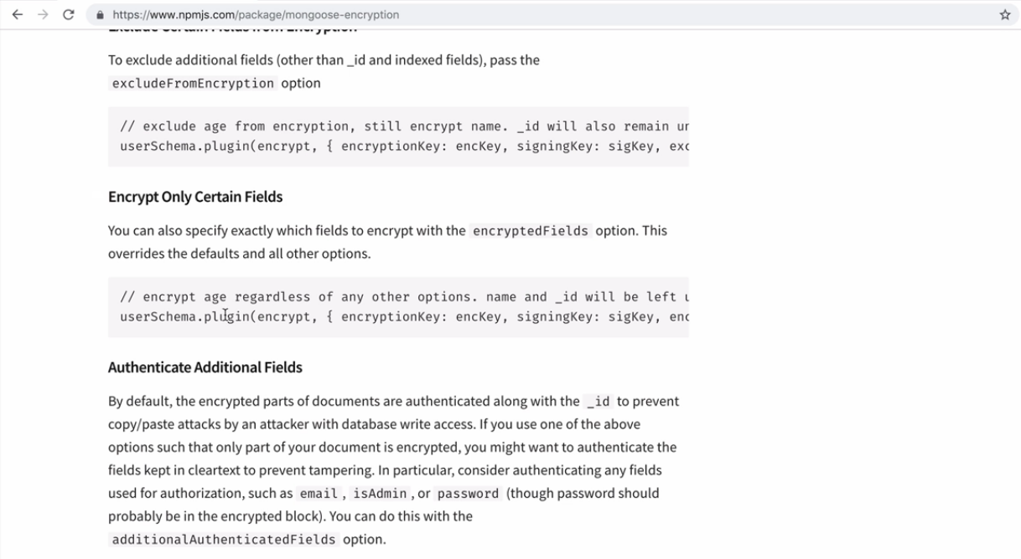
Encrypt particular fields in our database.

Slide 24
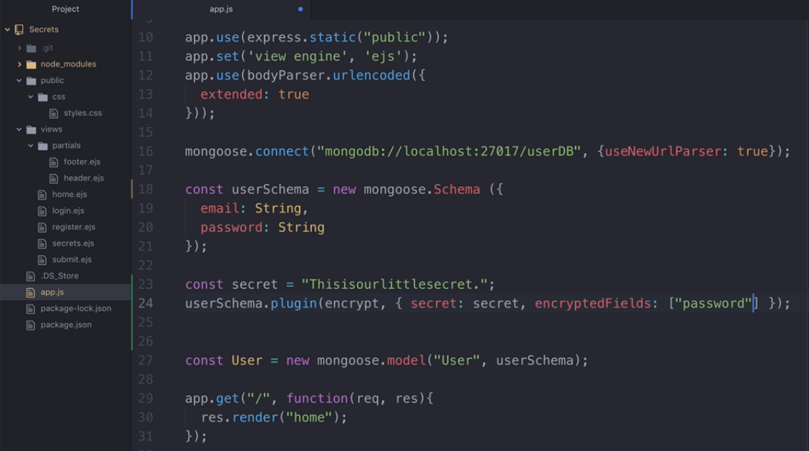
Encrypt particular fields in our database.

Slide 25
How Encryption & Decryption Works?
Encrypt works on particular fields / more than one field in our database when saving a collection.
Decrypt works when we find some thing from collection.
This is advantage of mongoose-encryption package.

Slide 26
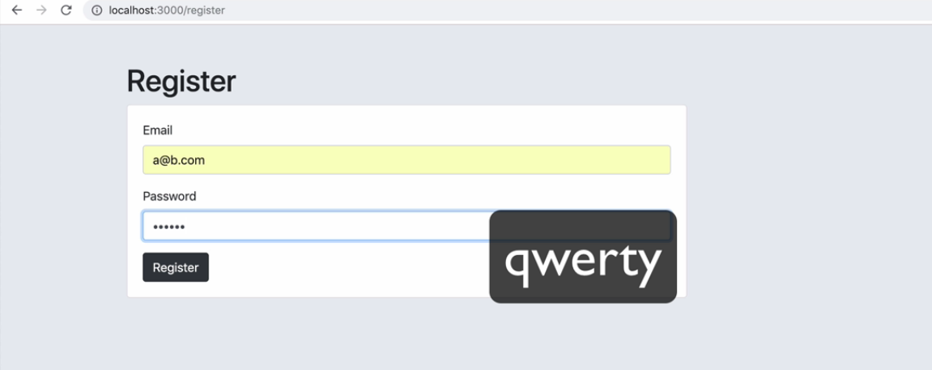
Encrypt particular fields in our database when registering a new user.

Slide 27
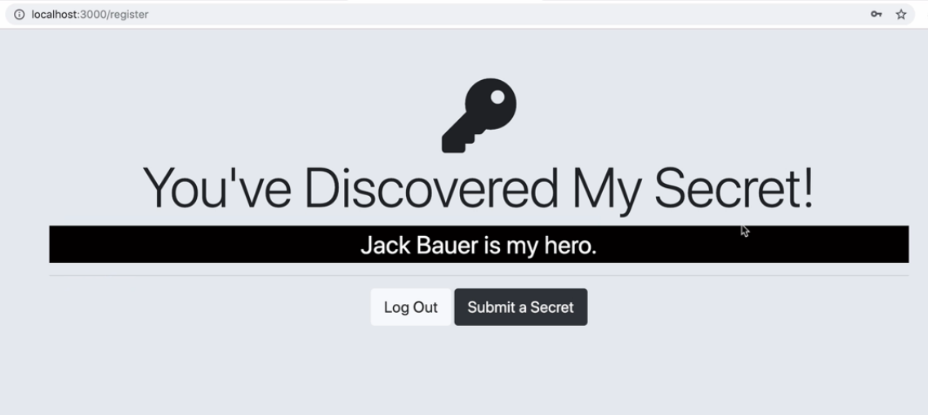
Successful Registration - Encryption happened on database.

Slide 28
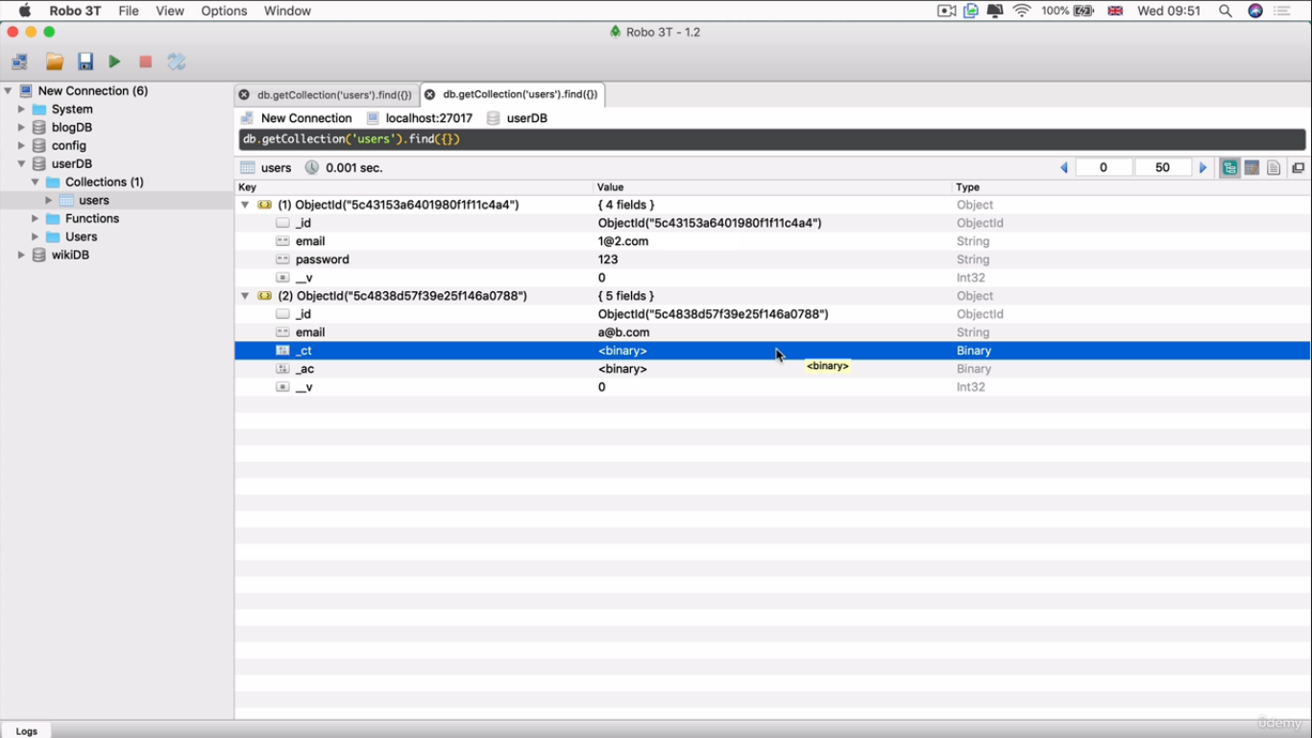
Checking Encrypted field at database.

Slide 29
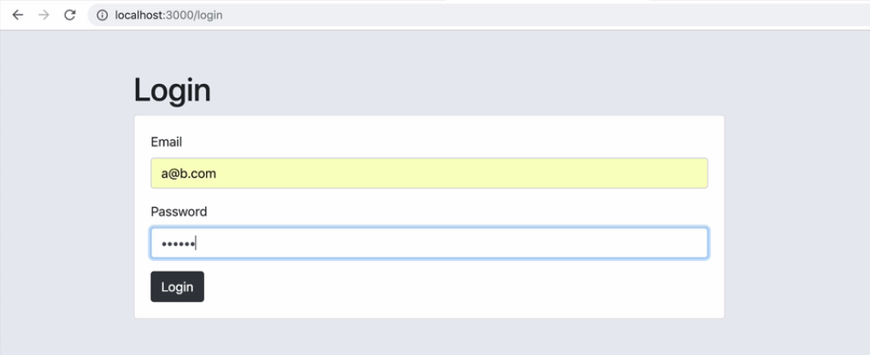
Decrypt particular fields in our database when logging-in.

Slide 30

Successful Login - Decryption happened on database.

